Slide 1
Security in Web API
Web APIs (Application Programming Interfaces) enable the communication and interaction between various software components, applications, and services. They expose endpoints through which clients can request and exchange data or perform actions. However, without proper security measures, these APIs are vulnerable to a range of threats, including:
Unauthorized Access: Malicious users may attempt to access sensitive data or perform actions they are not authorized for.
Data Breaches: Unauthorized access to data can lead to data breaches, resulting in the exposure of confidential information.
Denial of Service (DoS) Attacks: Attackers can overwhelm an API by sending a large number of requests, causing it to become slow or unresponsive.
Data Tampering: Data transmitted between the client and the API can be intercepted and modified.

Slide 2
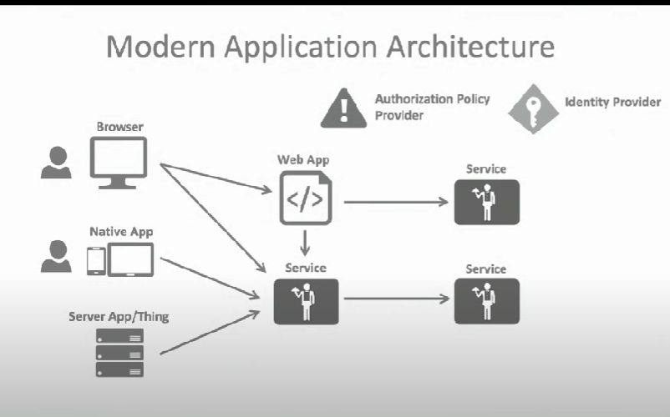

Slide 3
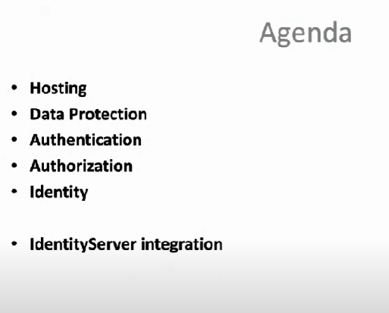

Slide 4
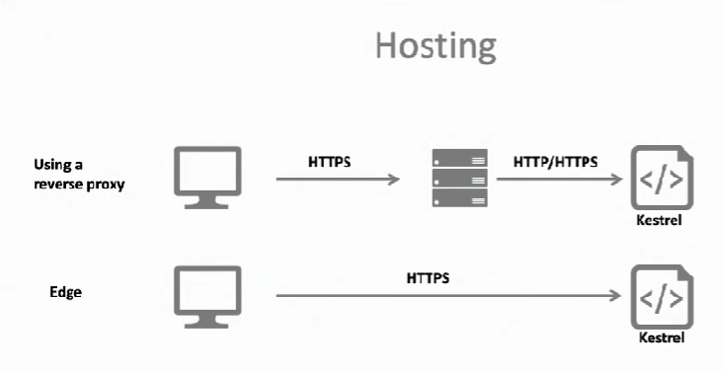
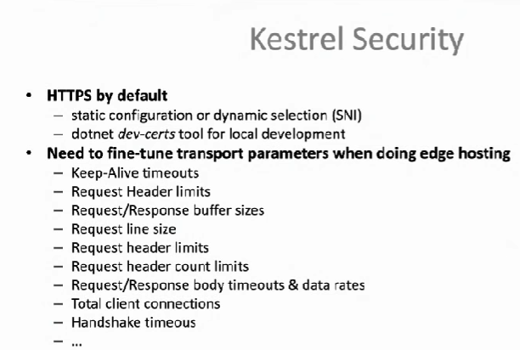

Slide 5
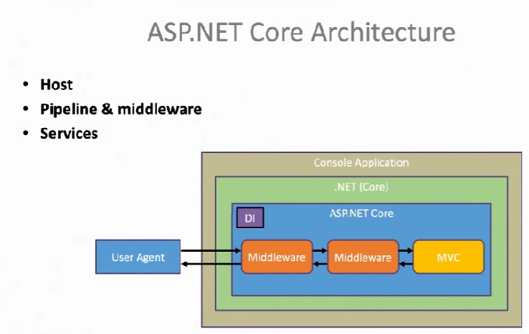
https://www.youtube.com/watch?v=_GF9GtyBQsA

Slide 6
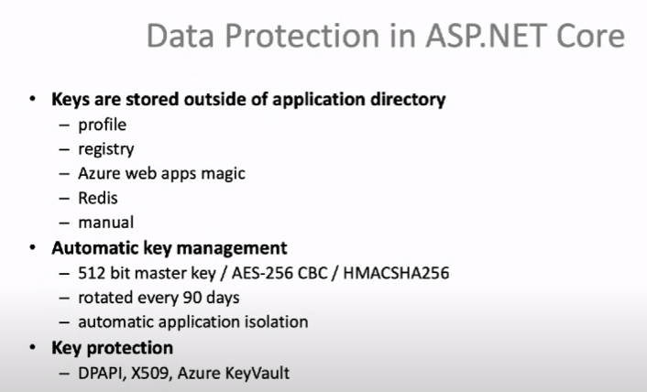

Slide 7
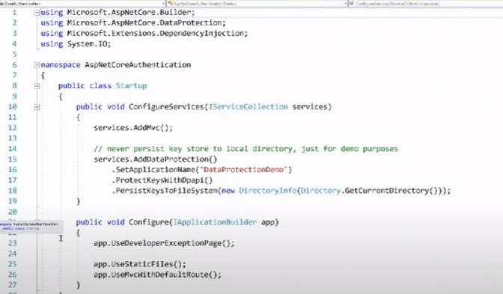
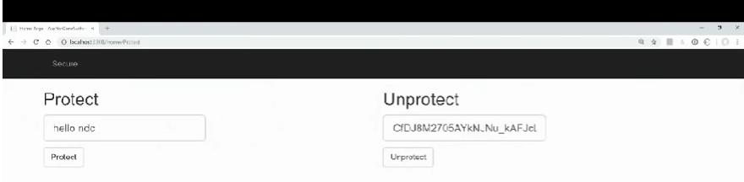

Slide 8
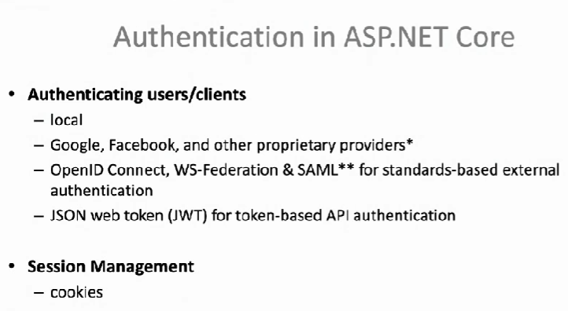

Slide 9
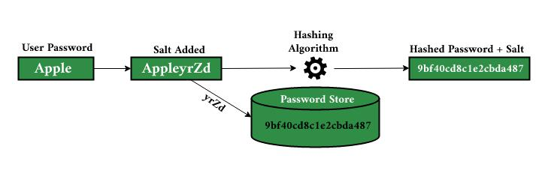
Password Hashing +Salting
Hashing takes plaintext data elements and converts them into consistent ciphertext outputs used for data verification. Salting adds random characters to data, like passwords, to thwart hackers who look for consistent words and phrases in sensitive data in order to decode it.

Slide 10
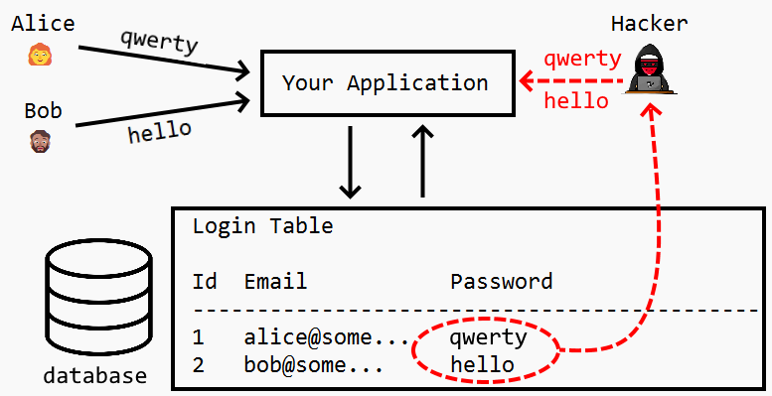
Hashing Example

Slide 11
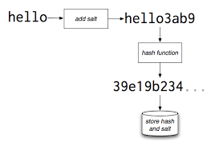
Password Salting

Slide 12
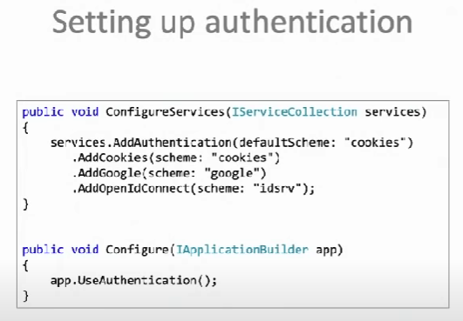
IAuthentication Service

Slide 13
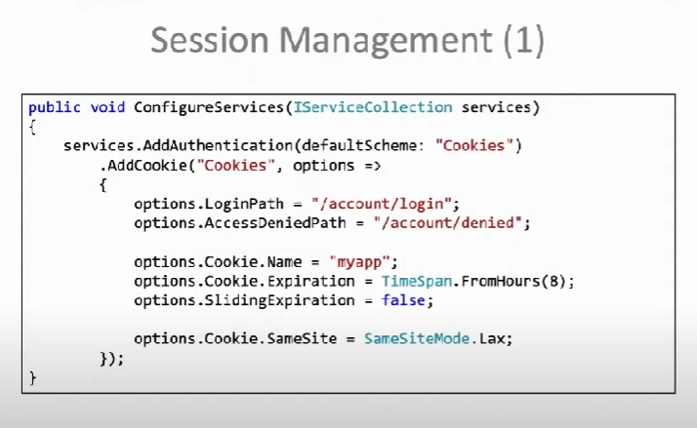

Slide 14
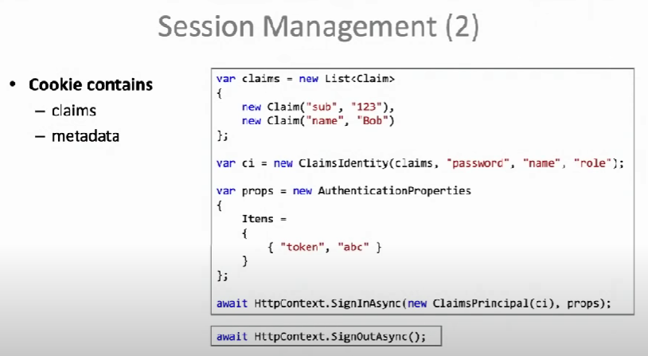

Slide 15
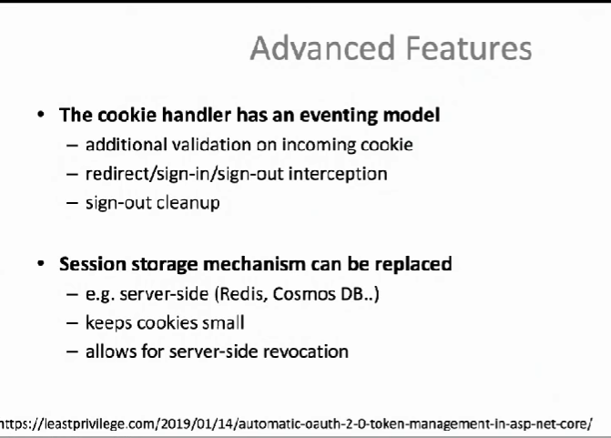

Slide 16
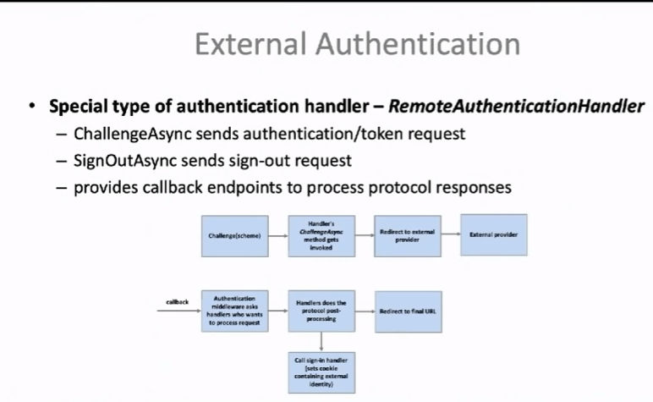

Slide 17
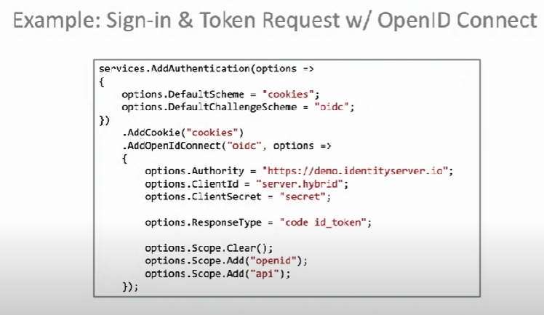

Slide 18
JWT Authentication in WebAPI .netcore 6

Slide 19
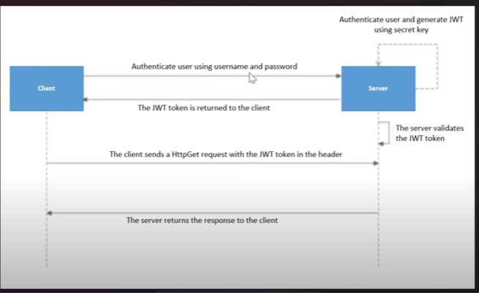

Slide 20
A JSON web token(JWT) is JSON Object which is used to securely transfer information over the web(between two parties). It can be used for an authentication system and can also be used for information exchange. The token is mainly composed of header, payload, signature. These three parts are separated by dots(.)
Header A header in a JWT is mostly used to describe the cryptographic operations applied to the JWT like signing/decryption technique used on it. It can also contain the data about the media/content type of the information we are sending. { "typ":"JWT", "alg":"HS256" }
Payload The payload is the part of the JWT where all the user data is actually added. This data is also referred to as the ‘claims’ of the JWT. This information is readable by anyone so it is always advised to not put any confidential information in here. { "userId":"b07f85be-45da", "iss": "https://provider.domain.com/", "sub": "auth/some-hash-here", "exp": 153452683 }
Signature This is the third part of JWT and used to verify the authenticity of token. BASE64URL encoded header and payload are joined together with dot(.) and it is then hashed using the hashing algorithm defined in a header with a secret key. T

Slide 21
Example of JWT Token
header:
{ "alg" : "HS256",
"typ" : "JWT" }
Payload: { "id" : 123456789,
"name" : "Manoj"
}
Secret: DXC Technologies JSON Web Token

Slide 22
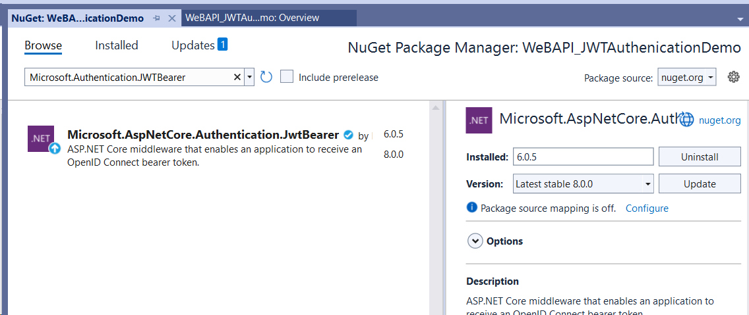
Steps
1 Create New ASpnetCore Web API 6.0 project :Uncheck https new Project
2 Add NugetPackage as follows

Slide 23
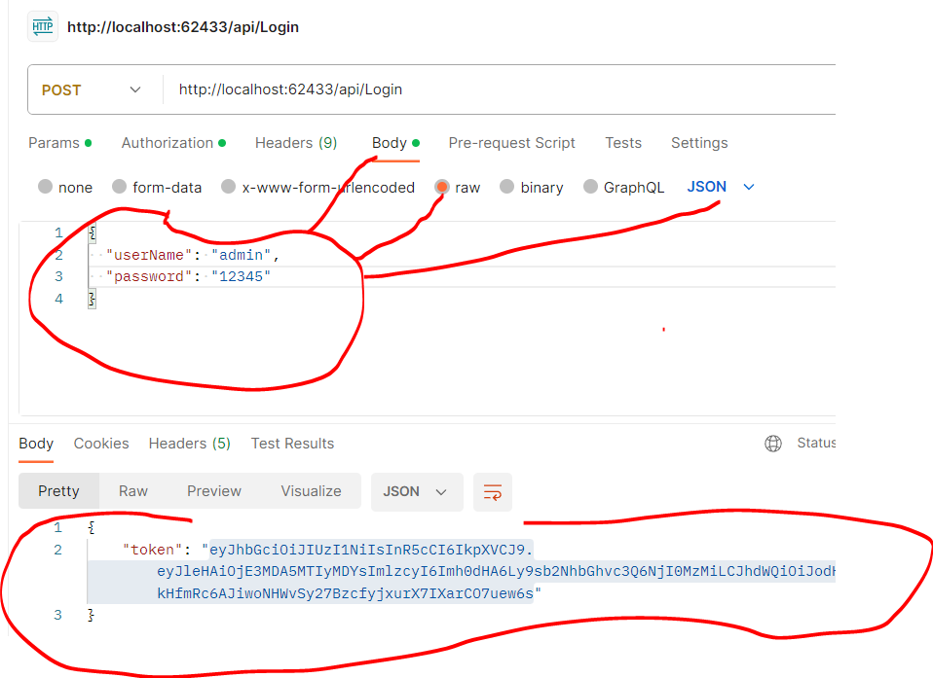
Step 1: Post method for Login Step 2: Get method for GetData

Slide 24
